Slide 1
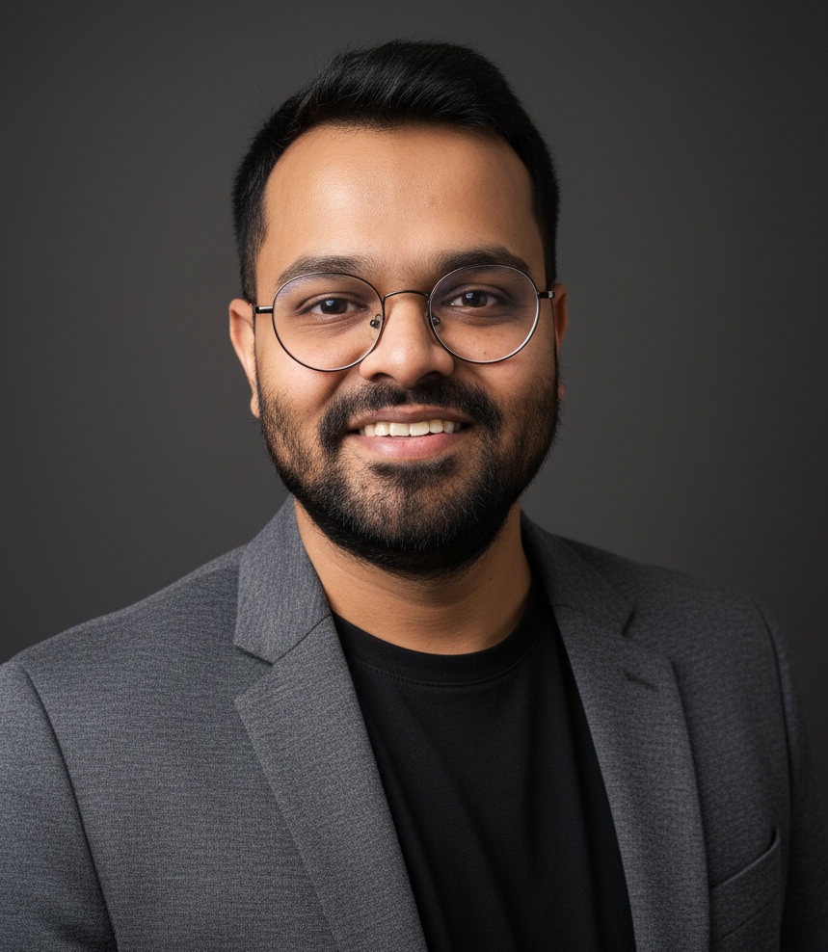

Coach’s Profile
Results-oriented Professional Certified Coach (PCC) with 12+ years of comprehensive HR leadership experience across diverse industries including pharmaceuticals, technology, FMCG, and education. Specializes in transforming organizational cultures, developing leadership capabilities, and driving sustainable change through strategic coaching interventions, combines deep business acumen with certified coaching expertise to deliver measurable results for individuals and organizations. I have 800+ hours of coaching.
Rushabh Mota
Executive Coach, India
Key Achievements
Certified Professional Coach (PCC) accredited by the International Coaching Federation (ICF). Specializing in ontological approach.
Experienced coach with direct working experience with CXO-1 and CXO-2 leaders working in complex multinational organizations.
Experience in coaching clients across borders - with clients across US, Europe, APAC and India
Key part of the global and regional leadership team facilitating career transitions, Senior leader readiness and future readiness for organizations and systems
Supported high-performing executives in creating sustainable wellbeing practices, designing meaningful lives, and achieving authentic success beyond traditional metrics
Developed authentic leadership presence through ontological exploration, helping leaders understand their way of being and its impact on organizational culture
Education & Certifications
Work experience
Coaching Experience
Education
PGP in Human Resource Management, MDI Gurgaon
B.E in Mechanical Engineering, Osmania University
Certifications & Awards
International Coaching Federation (ICF-PCC)
DDI Certified Job Analyst
DISC Certified Trainer
Corporate Experience
Fractional HR | Unilever, FedEx, JSW, BSV, Career Carve,
Regional Leader - HR | Schindler
Manager – HR | Gap Inc.
HR Technology & Shared Services Lead | Cipla
Industry Experience
Tech (IT)
Manufacturing
Retail
FMCG
Pharmaceuticals
International Experience
The Netherlands
Dubai
Singapore
UK
Functional Experience
Human Resources
Areas of Coaching Expertise
Career and Business coaching
Ontological Coaching
Managerial Coaching
Performance Coaching
High Potential Coaching
Startup Coaching
Levels Coached and Mentored
Business and functional Leaders
Senior Management
Mid management
Individual Contributors
Coaching Experience
Tech (IT)
Manufacturing
Retail
FMCG
Pharmaceuticals
Education
Languages Spoken
English
Hindi
Based in Mumbai, India.

